Slide 2
What We're Building
A computer vision image search app
Search photos by content, not file names
Search Modes
OR – find images with any selected object (e.g., dog or cat)
AND – find images with all selected objects together
Tech Used
YOLOv11 – for object detection (80 COCO classes)
Streamlit – for the web UI (runs on localhost:8501)
COCO dataset – 500 sample images used in the demo

Slide 3
How It Works
Provide image folder path → run inference → saves to metadata.json
Load metadata next time — no need to re-run inference
Share the JSON file with teammates
Search Features
Filter by object class (e.g., apple, bus)
Filter by object count (e.g., max 4 buses)
View bounding boxes with confidence scores
Highlight only matched classes
Export
Download filtered results as a JSON file
Useful for annotation and model retraining
What You'll Learn
Computer vision & object detection
Python backend development
Modular code design

Slide 4
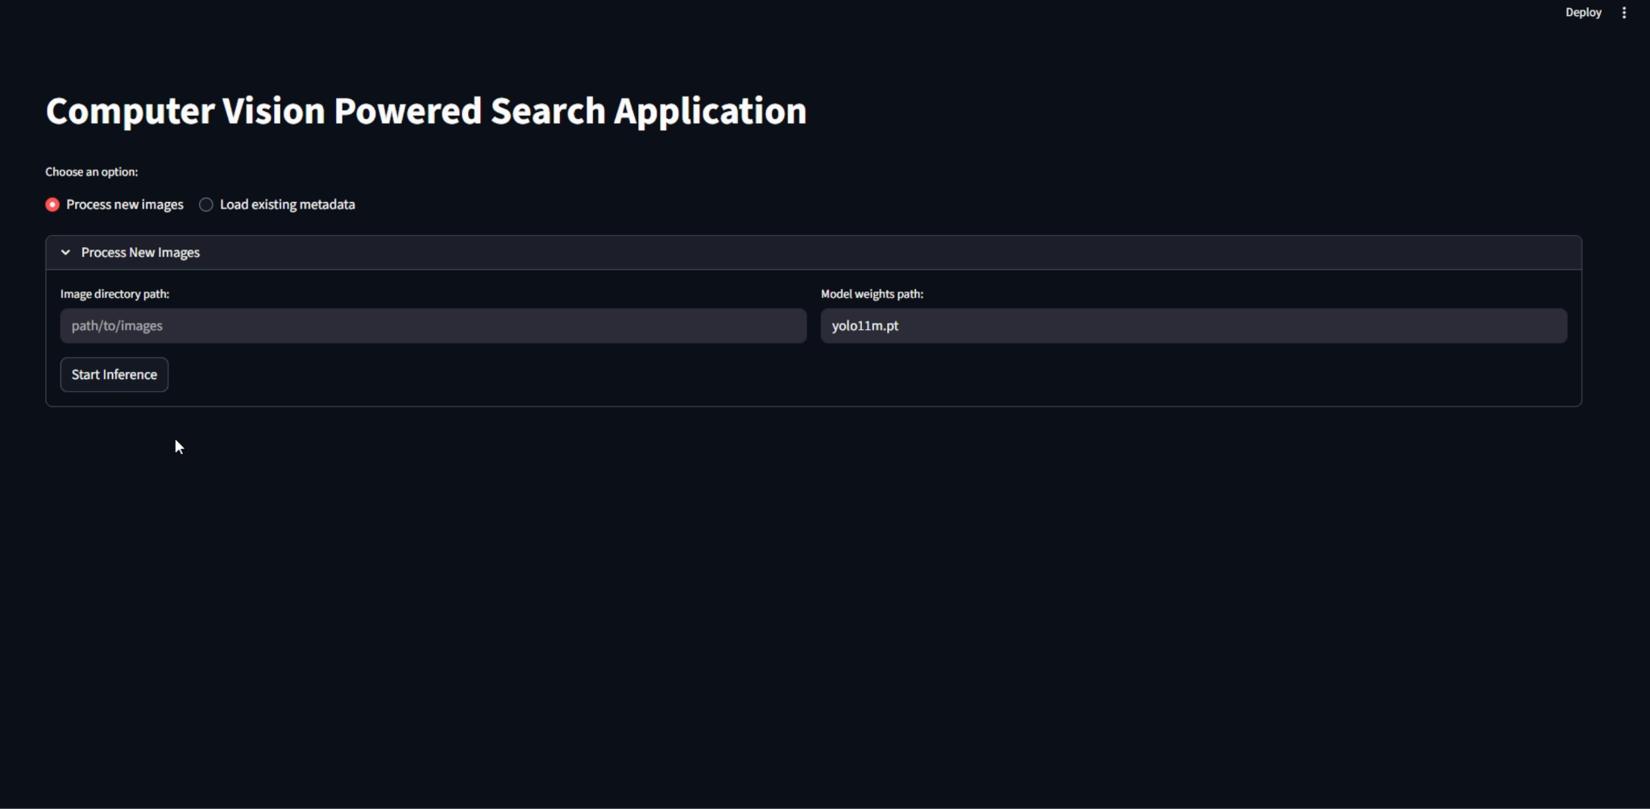

Slide 5
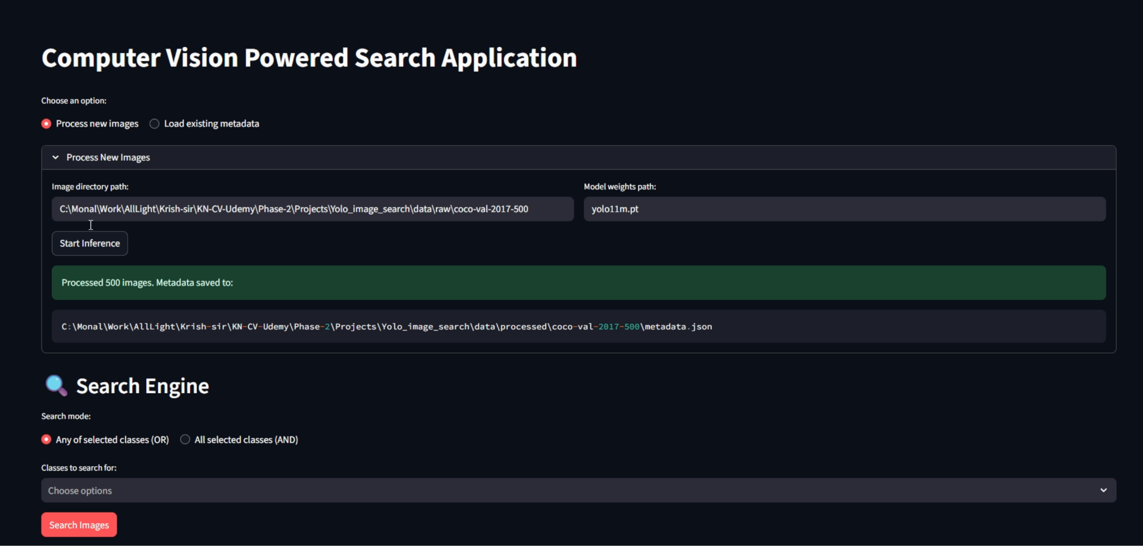

Slide 6
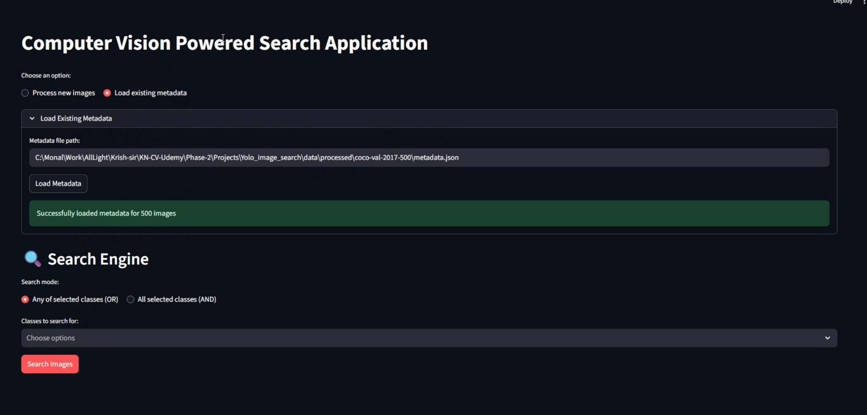

Slide 7
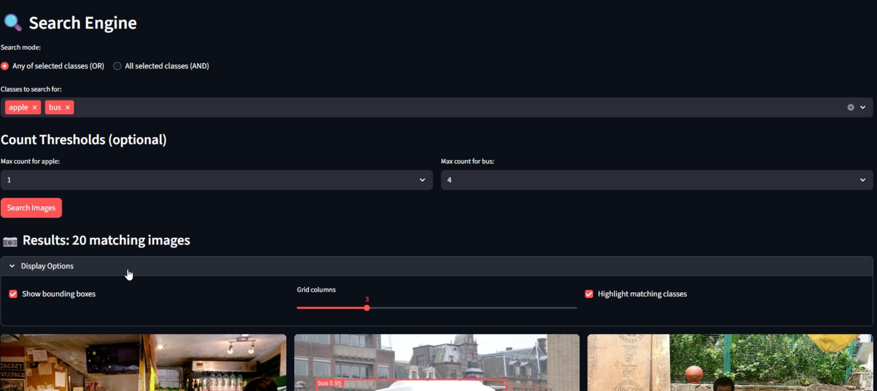

Slide 8
